Slide 1
NAT (Network address Translation)
By: J

Slide 2
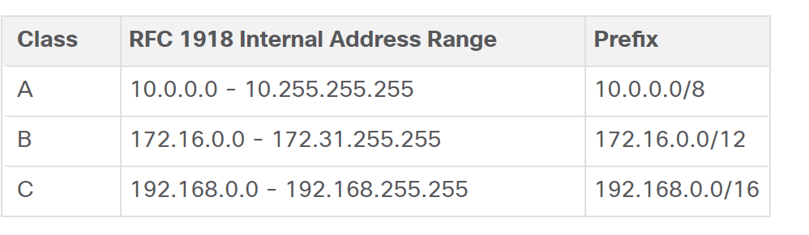
What is NAT?
Changing source or destination IP addresses. (From a private address to a public address)
Why?
Not enough public IPv4 addresses to assign a unique address to each device connected to the internet.
NAT’s primary use is to conserve public IPv4 addresses
Private vs Public
Private ip’s CANNOT be used over the Internet
Public addresses MUST be unique

Slide 3
NAT Table
When determining which type of address is used, it is important to remember that NAT terminology is always applied from the perspective of the device with the translated address:
Inside address - The address of the device which is being translated by NAT.
Outside address - The address of the destination device.
NAT also uses the concept of local or global with respect to addresses:
Local address - A local address is any address that appears on the inside portion of the network.
Global address - A global address is any address that appears on the outside portion of the network.

Slide 4
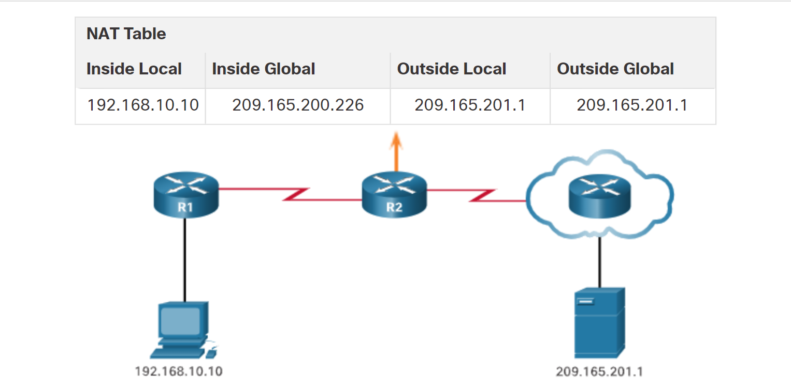
NAT Table
209.165.200.226

Slide 5
Static NAT
Statically configure one-to-one mappings of private IP addresses to public IPs
Static NAT does not preserve IP addresses
Configuration:
ip nat inside source static [local-ip-address] [global-ip-address]
interface [type] [number]
ip nat [inside | outside]

Slide 6
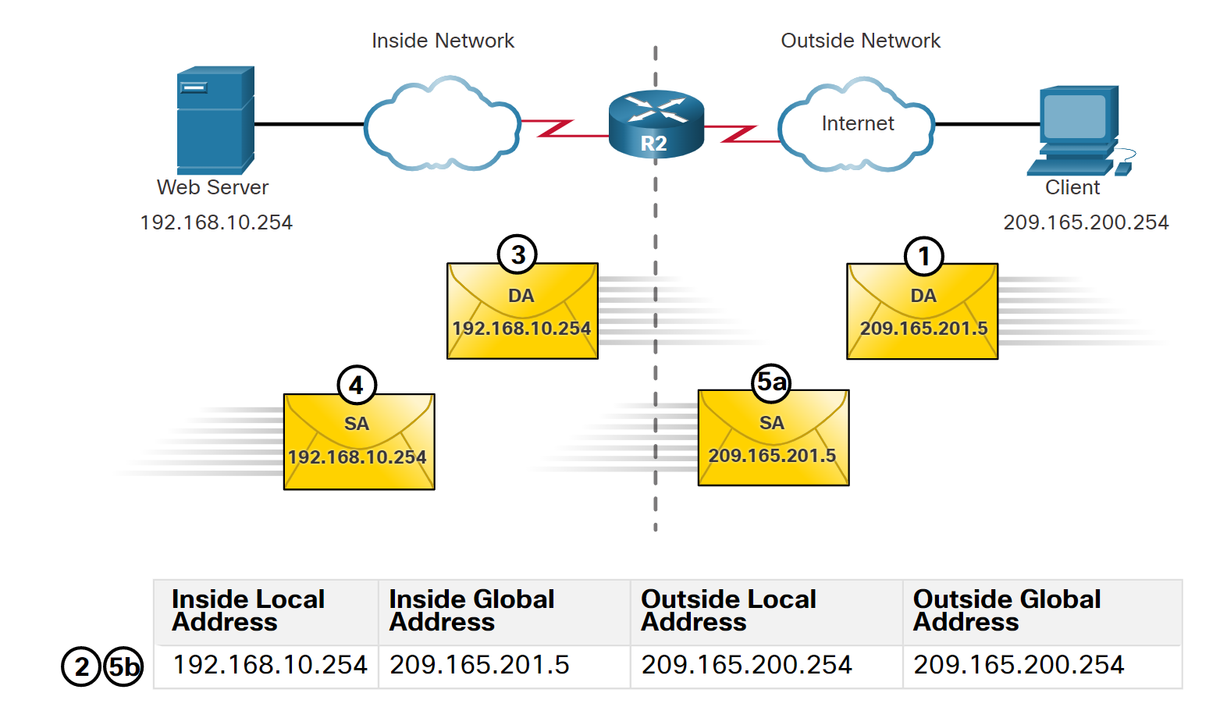
Static NAT

Slide 7
Dynamic NAT
Dynamic NAT uses a pool of public addresses and assigns them on a first-come, first-served basis. When an inside device requests access to an outside network, dynamic NAT assigns an available public IPv4 address from the pool.
Configuration:
ip nat pool [pool-name] [start-public-ip-address] [end-public-ip-address]
(Create ACL to identify which traffic needs to be translated) EX: Access-list 1 permit 192.168.0.0 0.0.0.255
ip nat inside source list [access-list-number] pool [pool-name]
interface [type] [number]
ip nat [inside | outside]

Slide 8
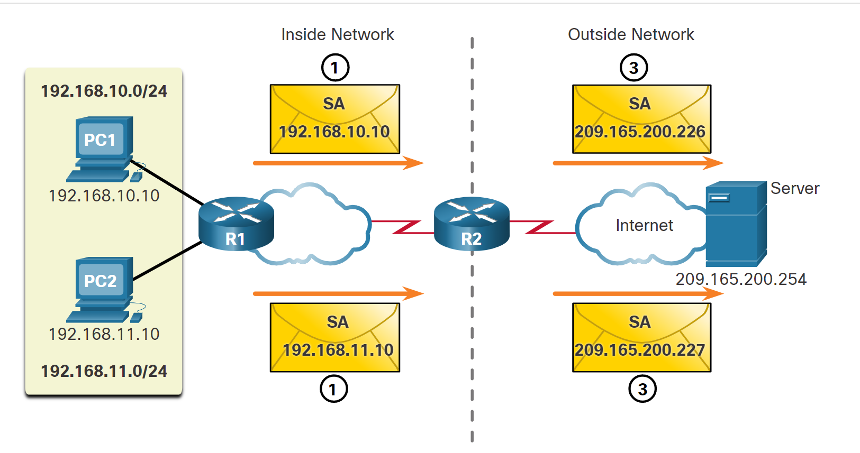
Dynamic NAT

Slide 9
PAT (NAT Overload)
Port Address Translation (PAT), also known as NAT overload, maps multiple private IPv4 addresses to a single public IPv4 address or a few addresses. This is what most home routers do. The ISP assigns one address to the router, yet several members of the household can simultaneously access the internet. This is the most common form of NAT for both the home and the enterprise.
When the NAT router receives a packet from the client, it uses its source port number to uniquely identify the specific NAT translation.
PAT (NAT Overload)
Translates both ip and port number
Using unique ports allows for multiple uses of a single public ip
Router will keep track of who is using what ip AND port
PAT is widely used obviously

Slide 10
PAT Configuration
Config with Address Pool:
ip nat pool [pool-name] [start-ip-address] [end-ip-address]
(Create ACL for private addr that need translation)
ip nat inside source list [access-list-number] pool [pool-name] overload
interface [type] [number]
ip nat [inside | outside]
Config for Single Address:
(Create ACL for private addr that need translation)
ip nat inside source list [access-list-number] interface [type] [number] overload (interface is outside interface)
interface [type] [number]
ip nat [inside | outside]

Slide 11
Troubleshooting NAT Commands
Show ip NAT translations
Clear ip NAT translations
Show ip NAT statistics

